Slide 1
Wireless
Lecture X
CS 168, Fall 2024 @ UC Berkeley
Slides credit: Sylvia Ratnasamy, Rob Shakir, Peyrin Kao, Prabal Dutta (and others)
Notes:
Others: Andrea Goldsmith, Neal Patwari, Kyle Jamieson
Slides template credit: Josh Hug, Lisa Yan

Slide 2
Why is Wireless Different?
Why is Wireless Different?
Shared Medium
Attenuation
Changing Environments
Collision Detection
MACAW Optimizations
Acks for Reliability
Backoff for Fairness
DS for Synchronization
RRTS for Synchronization
Lecture X, CS 168, Fall 2024

Slide 3
Brief History of Wireless Communication
Wireless communication predates the Internet!
1880s: Photophone (Bell, Tainer) sent data wirelessly using a light beam.
1890s: Wireless telegraph (Marconi) sent data using radio waves.
1890s: Experiments with millimeter waves (Bose).
This is becoming an active area of research again!
We now live in a world where wireless communication is everywhere.

Slide 4
Wireless Signals
Wireless signals are not packets of data floating in space.
Wireless signals are waves that propagate in all directions.
Analogy: Ripples in a pond.
Waves interact with each other, and with the environment.
A
B

Slide 5
Wired vs. Wireless: Key Differences
Wireless is fundamentally a shared medium. (Wired is not.)
Wireless signals attenuate significantly with distance. (Wired signals do not.)
Wireless environments can change rapidly. (Wired environments do not.)
Wireless packet collisions are hard to detect. (Wired packet collisions are not.)
Differences mostly affect Layer 1 (Physical) and Layer 2 (Link).

Slide 6
Difference: Wireless is a Shared Medium
Why is Wireless Different?
Shared Medium
Attenuation
Changing Environments
Collision Detection
MACAW Optimizations
Acks for Reliability
Backoff for Fairness
DS for Synchronization
RRTS for Synchronization
Lecture X, CS 168, Fall 2024

Slide 7
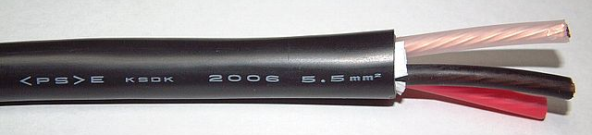
Difference: Wired vs. Wireless Links
Wired links:
Point-to-point (private) by default.
Creating multi-point buses requires work.
Fairly easy to shield from external interference.
Uses electrical signals to transmit data.
Wireless links:
Broadcast (shared) by default.
Creating point-to-point private links requires work.
Fairly hard to shield from external interference.
Modulate electromagnetic fields to transmit data.
Notes:
https://commons.wikimedia.org/wiki/File:600V_CV_5.5sqmm.jpg

Slide 8
Encoding Data Over Wireless Links
Wired link: Encode bits as electrical signals.
High voltage = 1.
Low voltage = 0.
Wireless link:
Draw the bits as a wave?
Problem: Resulting wave is low-frequency, and hard to transmit.
0 0 1 1 0 0 0 0 0 1 0 1 0 1 1 1 1 0 0 0 0

Slide 9
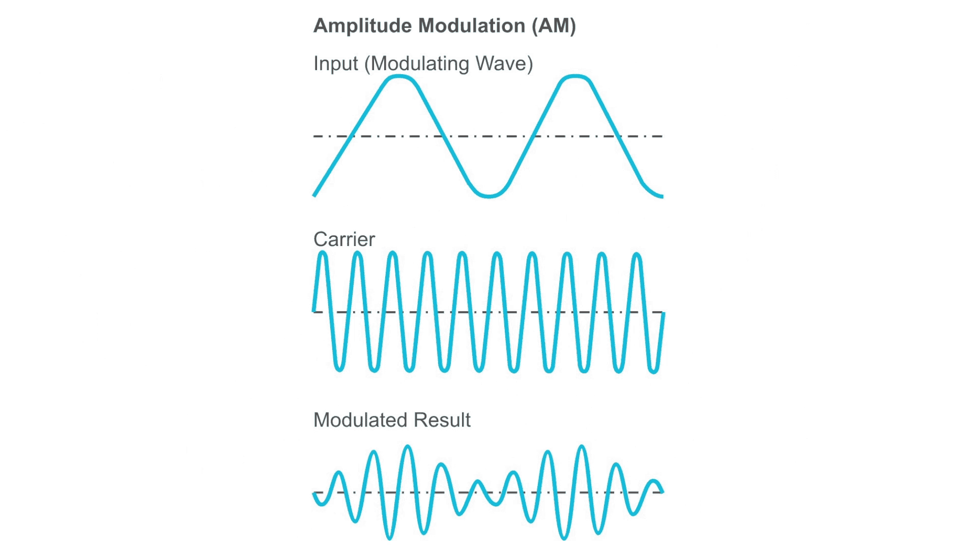
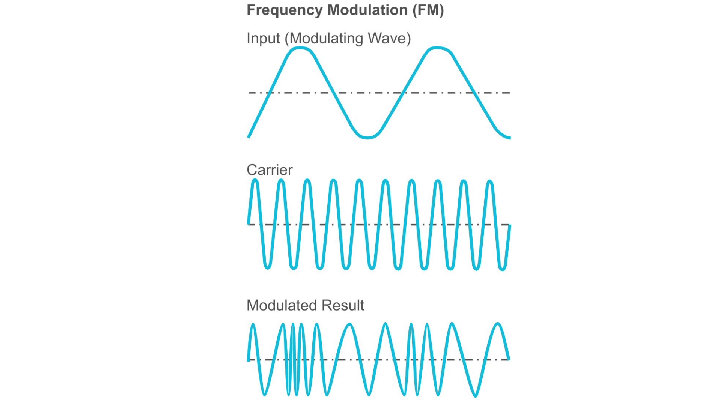
Encoding Data Over Wireless Links – Modulation
Modulation: Impose our data signal on top of a carrier signal.
Carrier signal: A high-frequency, constant wave that contains no information.
The combined wave is easy to transmit, and contains our data!
Original signal
+ Carrier signal
= Modulated signal
Amplitude Modulation (AM):
1 = Taller wave.
0 = Shorter wave.
Frequency Modulation (FM):
1 = Oscillate fast.
0 = Oscillate slow.
Other modulation strategies exist.
Notes:
https://www.taitradioacademy.com/topic/how-does-modulation-work-1-1/ (could remake this nicely in matplotlib or something eventually)

Slide 10
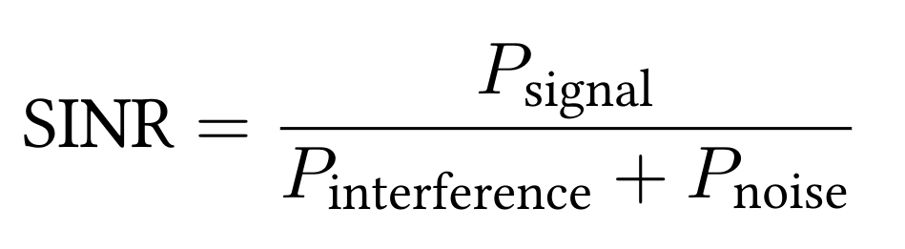
Measuring Noise and Interference – SINR
Shared medium → other signals can corrupt our data!
Noise: Background, ambient signals.
Interference: Another transmitter sending signals.
SINR (Signal to Interference and Noise Ratio) lets us measure connection quality:
Ratio of power to noise+interference at the the receiver.
Higher SINR is better.
If there's more noise+interference, the signal must be stronger.
If signal is weak, can employ coding gain (error-correcting codes).

Slide 11
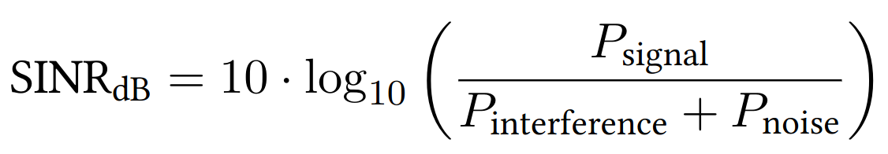
Measuring Noise and Interference – SINR
SINR is dimensionless (it's a ratio).
Decibels let us measure ratios on a logarithmic scale.
Ratio is 10 times greater = increase of 10 dB.
Ratio | Ratio in dB
1 | 0 dB
10 | 10 dB
100 | 20 dB
1000 | 30 dB
10000 | 40 dB
SINR formula.
SINR (measured in dB).

Slide 12
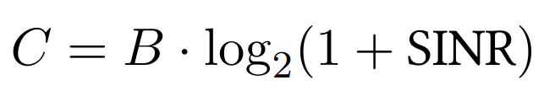
Measuring Noise and Interference – Noisy Channel Shannon Capacity
Shannon capacity: Theoretical limit of how much data can be sent on a noisy channel.
How much data can be sent? (bits/sec)
Bandwidth of channel (range of frequencies we can use).
Ratio of signal power to noise+interference.
Higher bandwidth = can send more data.
SINR increases = can send more data.
Stronger signal, or less noise+interference.

Slide 13
Measuring Noise and Interference – Noisy Channel Shannon Capacity
Shannon capacity: Theoretical limit of how much data can be sent on a noisy channel.
How much data can be sent? (bits/sec)
Bandwidth of channel (range of frequencies we can use).
Ratio of signal power to noise+interference.
Example: The plain old telephone system:
B = 3000 Hz. (Telephones understand frequencies between 300 Hz and 3300 Hz.)
SINR = 100. (20 dB signal-to-noise ratio.)
C = 3000 · log2(1 + 100) ≈ 20000 = 20 kbps.

Slide 14
Difference: Wireless Signals Attenuate
Why is Wireless Different?
Shared Medium
Attenuation
Changing Environments
Collision Detection
MACAW Optimizations
Acks for Reliability
Backoff for Fairness
DS for Synchronization
RRTS for Synchronization
Lecture X, CS 168, Fall 2024

Slide 15
Difference: Attenuation
Wireless signals attenuate – they get much weaker over longer distances.
Our design must account for attenuation.
Wired signals also attenuate, but effect is far smaller.
Trade-off:
Maximize performance: Accuracy, speed, range.
Minimize resource use: Power, use less of the frequency spectrum (costs money).
Trade-off: Better signal requires more resources.

Slide 16
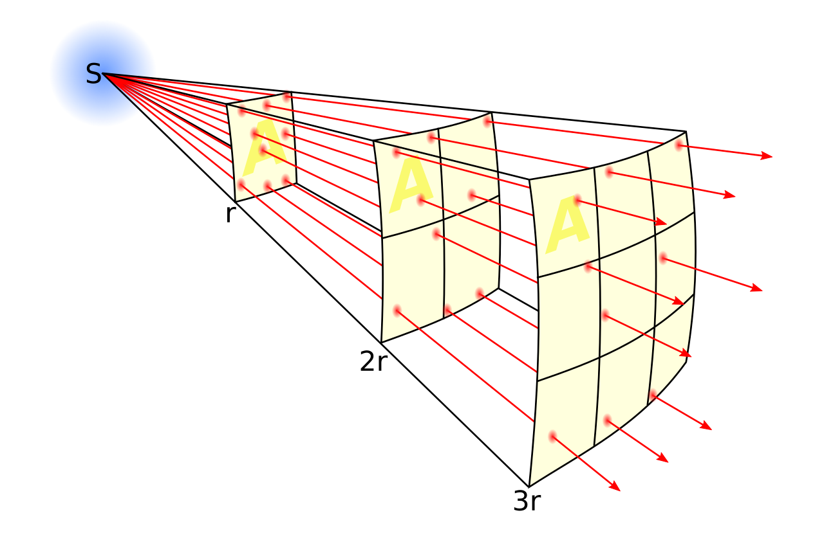
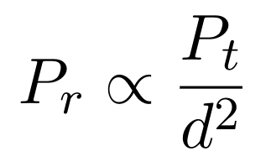
Measuring Attenuation – Free-Space Model
Free-space model (aka line-of-sight model):
Transmitter and receiver exist in empty space.
No obstacles, not even Earth's surface.
In this model, the inverse square law applies.
10 times as far = signal is 100 times weaker.
k times as far = signal is k² times weaker.
Signal Strength
Distance
"is proportional to"
Transmitter power
d = distance between transmitter and receiver
Intuition: Signal propagates out like a sphere.
Signal power is spread over surface of sphere. Surface area of sphere = 4πd².
Receiver power
Notes:
https://commons.wikimedia.org/wiki/File:Inverse_square_law.svg

Slide 17
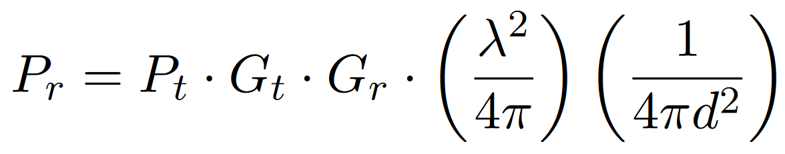
Measuring Attenuation – Friis Equation
The Friis equation accounts for:
Gain of the transmitter and receiver antennas.
Aperture (area) of the receiver antenna. Proof omitted.
Intuition: Larger antenna can capture more signal.
Distance between antennas (inverse-square law).
Aperture of receiver antenna
Distance (inverse square law)
Receiver power
Transmitter power
Gains of antennas

Slide 18
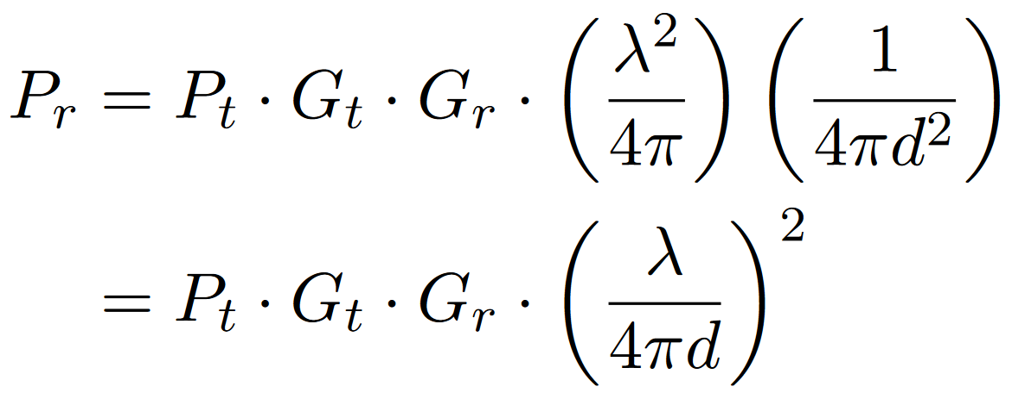
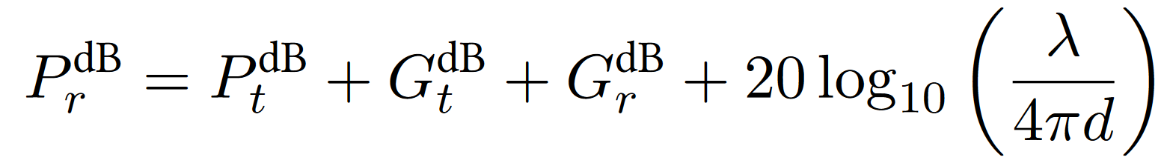
Measuring Attenuation – Friis Equation, Rewritten
The equation is sometimes written like this:
Or in terms of decibels (logarithmic scale):

Slide 19
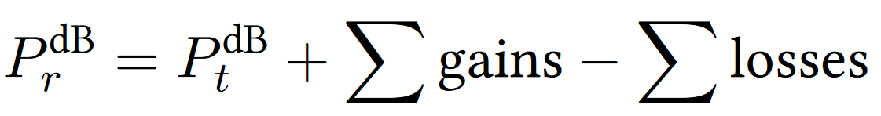
Measuring Attenuation – Link Budget
How do we know if the link will actually work?
Compute a link budget: Add all gains, subtract all losses.
Compare:
Signal power at receiver.
Receiver sensitivity (minimum signal the receiver can hear).
If link budget is positive: Pr > Sensitivity. Link works!
If link budget is negative: Pr < Sensitivity. Link doesn't work!
Link margin is difference between receiver signal and sensitivity.
Bigger link margin = more robust signal.

Slide 20
Measuring Attenuation – Link Budget
Example of computing link budget:
Signal travels 10km: –120 dB
Antenna: +25 dB
Antenna: +25 dB
Cable: –2.21 dB
Cable: –2.21 dB
Cable: –0.44 dB
Cable: –0.44 dB
Transmitted Signal: +10 dBm
Transmitter
Receiver
Received Signal: –65.5 dBm
Sensitivity: –80 dBm
Link margin = 14.5 dBm > 0. Our connection works!
Note: dBm = Power relative to 1 milliwatt.

Slide 21
Difference: Changing Environments
Why is Wireless Different?
Shared Medium
Attenuation
Changing Environments
Collision Detection
MACAW Optimizations
Acks for Reliability
Backoff for Fairness
DS for Synchronization
RRTS for Synchronization
Lecture X, CS 168, Fall 2024

Slide 22
Difference: Environments Change
Wireless environments change rapidly.
Devices move around.
Signals reflect and refract off physical obstacles (e.g. buildings, Earth's surface).
Signal Strength
Signal Strength
Distance
Distance
Free-space model: Signal weakens over distance.
After accounting for obstacles: Signal strength fluctuates!

Slide 23
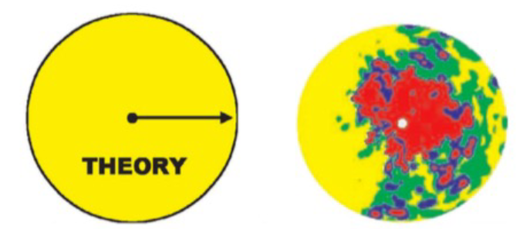
Path Loss is Messy
Wireless propagation is messy.
In theory: Signal propagates in all directions.
In real life: Signal strength depends on environment.
Color = strength of signal.
Notes:
Credit: Neal Patwari

Slide 24
Characteristics of Path Loss
3 characteristics affect signal strength:
Free-space loss:
– Due to inverse square law. – Fluctuates very slowly.
Signal Strength
Distance
Signal Strength
Shadowing:
– Due to obstructions. – Fluctuates quickly.
Signal Strength
+
Distance
Multipath fading:
– Due to signal colliding with itself. – Fluctuates very quickly.
Distance
Signal Strength
Distance

Slide 25
Modeling Path Loss – Two-Ray Model
Two-ray model assumes the signal waves travel along two paths:
Line-of-sight path: Wave arrives with no obstacles.
Ground-bounce path: Wave reflects off the Earth's surface.
Line-of-sight path
Ground bounce path
Earth's surface
Sender tower
Receiver tower

Slide 26
Modeling Path Loss – Two-Ray Model
Assuming sender and receiver are far enough:
Waves arrive phase-shifted at the receiver, causing destructive interference.
Signal strength ∝ 1/d⁴. Drops off much faster than inverse-square law!
Signal arrives with phase offset...
...canceling each other out!
Line-of-sight path
Signal
Signal
=
Time
Time
Ground bounce path
Earth's surface
Sender tower
Receiver tower

Slide 27
Modeling Path Loss – Two-Ray Model
If sender and receiver are far enough:
Waves arrive phase-shifted at the receiver, causing destructive interference.
Signal strength ∝ 1/d⁴. Drops off much faster than inverse-square law!
Signal Strength
Signal Strength
Distance
Distance
Free-space model:
– Signal strength ∝ 1/d². – Idealized, no obstacles.
Two-ray model:
– Signal strength ∝ 1/d⁴. – Signal bounces off ground. Causes destructive interference.

Slide 28
Modeling Path Loss – General Ray Tracing Models
General ray tracing models account for other obstacles.
Signals reflect, scatter, and diffract.
Most signals arriving at receiver are reflections.
Run simulations in software. Requires information about environment.
Obstacle
Obstacle
Obstacle
Earth's surface
Sender
Receiver

Slide 29
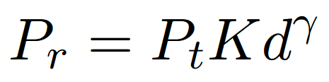
Modeling Path Loss – General Ray Tracing Models
Free-space model: Signal strength ∝ 1/d².
Two-ray model: Signal strength ∝ 1/d⁴.
General ray tracing model:
Receiver power
Transmitter power
Distance
K and γ are empirically determined by the model.
Signal dominated by reflections.
Exponent γ is determined empirically. Usually between –2 and –8.

Slide 30
Difference: Collision Detection
Why is Wireless Different?
Shared Medium
Attenuation
Changing Environments
Collision Detection
MACAW Optimizations
Acks for Reliability
Backoff for Fairness
DS for Synchronization
RRTS for Synchronization
Lecture X, CS 168, Fall 2024

Slide 31
Difference: Collision Detection
Wired collisions are easy to detect.
On a point-to-point link, collisions might not happen at all.
There's just one signal on the wire to sense.
Wireless collisions are much harder to detect.
There's a spatial aspect to collisions.
Signals can collide in one place, but not another place.
A
B
No collision here!
Signals collide here.
No collision here!

Slide 32
Recall: Multiple Access Protocols
Recall: Many ways for devices to share a link.
Let's start with CSMA: Listen, and transmit when it's quiet.
Then we'll design some protocols for wireless networks.
Multiple Access Protocols
Multiplexing
Taking Turns
Random Access
Frequency
Time
Polling
Tokens
ALOHA
CSMA
CSMA/CD

Slide 33
CSMA in Wireless Networks
If pairs are well-separated, no problem!
Goal: A→B and C→D.
A transmits to B.
C transmits to D at the same time.
No collisions!
Notice: Signals propagate in all directions (not just toward the destination).
Arrows are just drawn for convenience.
A
B
C
D

Slide 34
CSMA in Wireless Networks
If pairs are in range of each other, no problem!
Goal: A→B and C→D.
A transmits to B.
C detects transmission. Must wait to transmit to D.
No collisions! A–B and C–D take turns.
A is quiet now. My turn!
I hear A transmitting!
I'll wait for A to finish.
A
B
C
D

Slide 35
CSMA in Wireless Networks – Hidden Terminal Problem
Hidden terminal problem:
Goal: A→B and C→B.
A senses quiet, and starts transmitting.
C senses quiet, and starts transmitting.
Collision at B!
Problem: A and C are out-of-range. They can't detect each other sending.
All is quiet. Time to send!
All is quiet. Time to send!
???
A
B
C

Slide 36
CSMA in Wireless Networks – Exposed Terminal Problem
Exposed terminal problem:
Goal: B→A and C→D.
B senses quiet, and starts transmitting.
C senses a collision and doesn't send.
Notice: We could have actually sent simultaneously.
Some areas have collision, but we don't care. No collisions at the receivers.
All is quiet. Time to send!
I hear B.
I'll be quiet.
A
B
C
D
This would have been okay! But C didn't send.

Slide 37
MACA (Multiple Access with Collision Avoidance)
Key problem: CSMA detects collisions at the sender.
But we only care about collisions at the receiver.
Solution: Let's have the receiver announce if it detects collisions.
New protocol for shared medium: MACA (Multiple Access with Collision Avoidance).
Note: In this new protocol, we're not doing carrier sense anymore.

Slide 38
MACA (Multiple Access with Collision Avoidance)
To communicate over MACA:
Sender transmits Request to Send (RTS) with length of data.
Receiver transmits a Clear to Send (CTS) with length of data.
This tells sender that it's safe to send. No collisions at receiver.
This tells everyone in receiver's range to be quiet.
A
B
RTS: "I want to send 1 MB."
CTS: "If you hear this, shut up. I need to receive 1 MB."
A sends 1 MB.

Slide 39
MACA (Multiple Access with Collision Avoidance) – Solving Hidden Terminal Problem
MACA solves the hidden terminal problem.
Goal: A→B, C→B.
B now tells everyone in its range to be quiet, using the CTS.
C won't send anymore. Collision avoided!
B told me to be quiet. I won't send.
A
B
C
RTS: "I want to send 1 MB."
CTS: "If you hear this, shut up. I need to receive 1 MB."
A sends 1 MB.
C would have sent, but MACA saved the day!

Slide 40
MACA (Multiple Access with Collision Avoidance) – Rules
If you hear a CTS, be quiet until the data is sent.
CTS contains length of data.
You can use data length to estimate how long you need to wait.
If you hear an RTS, be quiet for one time slot.
Give the receiver time to send the CTS.
If you don't be quiet, you might clobber out the CTS.
After waiting:
If you hear the CTS: You're in receiver range. Be quiet.
If you don't hear the CTS: You're not in receiver range. You can send again.

Slide 41
MACA (Multiple Access with Collision Avoidance) – Solving Exposed Terminal Problem
MACA solves the exposed terminal problem, under certain assumptions.
Goal: B→A and C→D.
C hears the RTS and defers for one time slot.
C doesn't hear the CTS, so it's out-of-range of the other receiver, and can send.
I hear an RTS. I'll be quiet for 1 time slot to avoid clobbering the CTS.
I didn't hear the CTS. I'm not in receiver range. I can send data!
A
B
C
D
RTS: "I want to send 1 MB."
CTS: "If you hear this, shut up. I'm receiving 1 MB."
C quiet at this time.
C can send here too! (After its own RTS/CTS.)
B sends 1 MB.

Slide 42
MACA (Multiple Access with Collision Avoidance) – Solving Exposed Terminal Problem
MACA solves the exposed terminal problem, under certain assumptions.
Assumes that C can hear the CTS over A's data.
Key problem: MACA requires the sender to listen (for the CTS).
Contrast with CSMA: Sender just sends.
Did I hear CTS from D, or data from B?
A
B
C
D
RTS: "I want to send 1 MB."
CTS: "If you hear this, shut up. I'm receiving 1 MB."
C quiet at this time.
RTS: "I want to send 1 MB."
CTS from D.
B sends 1 MB.

Slide 43
MACA (Multiple Access with Collision Avoidance) – Collisions
If we send RTS, but don't hear CTS, that means there was a collision!
Apply exponential backoff and wait up to twice as long before sending another RTS.
Each device maintains a CW (Contention Window) value.
Pick a random number in [0, CW]. Wait that long before re-sending RTS.
Rules for adjusting CW:
Minimum value: CW = 2.
Maximum value: CW = 64.
On successful RTS/CTS: Set CW ← 2.
On failed RTS/CTS: Set CW ← 2 × CW, clamped at 64.

Slide 44
Optimization: Acks for Reliability
Why is Wireless Different?
Shared Medium
Attenuation
Changing Environments
Collision Detection
MACAW Optimizations
Acks for Reliability
Backoff for Fairness
DS for Synchronization
RRTS for Synchronization
Lecture X, CS 168, Fall 2024

Slide 45
Introducing MACAW (Multiple Access Collision Avoidance for Wireless)
MACAW (Multiple Access Collision Avoidance for Wireless) offers improvements over MACA.
Acks for reliability.
Better backoff for fairness.
DS packets for synchronization.
RRTS packets for synchronization.

Slide 46
MACAW Feature: Acks for Reliability
MACAW implements acks for reliability:
If data is lost: No ack! Sender tries again, starting over with a new RTS.
If ack is lost: No ack! Sender tries again, starting over with a new RTS.
Since receiver already got data, it can immediately ack, instead of CTS.
Recall end-to-end principle: Reliability implemented at end hosts for correctness.
We're adding acks as a performance optimization, not for correctness.
A
B
RTS
CTS
Data
Ack

Slide 47
Optimization: Better Backoff for Fairness
Why is Wireless Different?
Shared Medium
Attenuation
Changing Environments
Collision Detection
MACAW Optimizations
Acks for Reliability
Backoff for Fairness
DS for Synchronization
RRTS for Synchronization
Lecture X, CS 168, Fall 2024

Slide 48
MACAW Feature: Better Backoff for Fairness
MACA is unfair: Winners keep winning. Losers keep losing.
A
B
CW = 2
CW = 2
A and B try to reserve simultaneously. Suppose A wins.
A wins and sets CW = 2.
CW = 2
CW = 4
B loses and doubles CW.
A has lower CW, will try again sooner.
A wins again!
A wins and sets CW = 2.
CW = 2
CW = 8
B loses and doubles CW.
A has lower CW, will try again sooner.
A wins again!
A wins and sets CW = 2.
CW = 2
CW = 16
B loses and doubles CW.

Slide 49
MACAW Feature: Better Backoff for Fairness
MACAW solution: Have everybody share the same CW.
Packet header has a field with CW value.
If you receive a packet, set your CW to value in the packet.
MACAW solution: Change CW update rules to be more gentle.
Multiplicative Increase, Linear Decrease (MILD).
On successful RTS/CTS/data/ack: CW ← CW – 1, clamped at 2.
Contrast with MACA, setting CW = 2.
On failed RTS/CTS: CW ← 1.5 × CW, clamped at 64.
Contrast with MACA, setting CW ← 2 × CW.
We're simplifying a bit. Technically, this slide is only true if all devices are in range of each other.

Slide 50
Optimization: DS for Synchronization
Why is Wireless Different?
Shared Medium
Attenuation
Changing Environments
Collision Detection
MACAW Optimizations
Acks for Reliability
Backoff for Fairness
DS for Synchronization
RRTS for Synchronization
Lecture X, CS 168, Fall 2024

Slide 51
MACAW Feature: Admit Defeat on Exposed Terminals
Recall the exposed terminal problem.
Goal: B→A, C→D.
C must hear an CTS from D before it can start sending.
But C can't hear the CTS. Gets clobbered by the data from B!
Did I hear CTS from D, or data from B?
A
B
C
D
RTS: "I want to send 1 MB."
CTS: "If you hear this, shut up. I'm receiving 1 MB."
C quiet at this time.
RTS: "I want to send 1 MB."
CTS from D.
B sends 1 MB.

Slide 52
MACAW Feature: Admit Defeat on Exposed Terminals
MACAW (and MACA) admits defeat on the exposed terminal problem.
Ideally, B→A and C→D send simultaneously. In reality, they must take turns.
Punchline: If you're in range of sender, you need to be quiet.
Because you can't hear the CTS you'd need to start sending yourself.
Did I hear CTS from D, or data from B?
A
B
C
D
RTS: "I want to send 1 MB."
CTS: "If you hear this, shut up. I'm receiving 1 MB."
C quiet at this time.
RTS: "I want to send 1 MB."
CTS from D.
B sends 1 MB.

Slide 53
MACAW Feature: Admit Defeat on Exposed Terminals
Punchline: If you're in range of sender, you need to be quiet.
Solution: Sender transmits a Data Sending (DS) packet before the data.
Warns everyone in sender's range to be quiet.
A
B
C
D
RTS: "I want to send 1 MB."
CTS: "If you hear this, shut up. I'm receiving 1 MB."
C quiet at this time.
DS: "If you hear this, shut up. I'm sending 1 MB."
C stays quiet, as intended.
(Because C can't hear the CTS it'd need to start sending.)
B sends 1 MB.

Slide 54
MACAW Feature: DS Packet for Fairness
The DS packet also helps with synchronization for fairness.
To see why, let's see what happens without the DS packet.
Goal: B→A, C→D.
I know exactly when my transmission ends.
When should I try an RTS again?
A
B
C
D
B busy sending.
C attempts RTS. Fails, because C won't hear CTS.
B attempts RTS immediately after its data. B will win!
C attempts RTS. Fails, because B sent RTS first.

Slide 55
MACAW Feature: DS Packet for Fairness
B has a huge advantage, because B knows when its data transmission ends.
B can immediately recapture the channel with another RTS.
C must guess when to send the RTS.
I know exactly when my transmission ends.
When should I try an RTS again?
A
B
C
D
B busy sending.
C attempts RTS. Fails, because C won't hear CTS.
B attempts RTS immediately after its data. B will win!
C attempts RTS. Fails, because B sent RTS first.

Slide 56
MACAW Feature: DS Packet for Fairness
The DS packet synchronizes by telling everybody when the transmission ends.
Now C can also send the RTS after B is done.
C and B both have a fair shot at winning!
I know exactly when my transmission ends.
The DS packet tells me when B's transmission ends.
A
B
C
D
DS: I'm sending 1 MB.
B busy sending.
B attempts RTS after B is done. Fair shot at winning!
C attempts RTS after B is done. Fair shot at winning!

Slide 57
Optimization: RRTS for Synchronization
Why is Wireless Different?
Shared Medium
Attenuation
Changing Environments
Collision Detection
MACAW Optimizations
Acks for Reliability
Backoff for Fairness
DS for Synchronization
RRTS for Synchronization
Lecture X, CS 168, Fall 2024

Slide 58
MACAW Feature: RRTS Packet for Fairness
Another case where we need synchronization for fairness:
Goal: A→B, D→C.
D is doomed. D can't hear the CTS or the DS, and has no idea when to try again.
I heard CTS, so I need to be quiet.
I know when to RTS again.
A
B
C
D
RTS
CTS
DS
Data
D attempts RTS.
Fails, because C cannot respond.
Next RTS (wins).
Next RTS (loses).

Slide 59
MACAW Feature: RRTS Packet for Fairness
Solution: Let C contend on behalf of D.
Goal: A→B, D→C.
C sends an RRTS to tell D: Now's a good time to send a RTS.
I heard CTS, so I need to be quiet.
A's done! I'll tell D.
I know when to RTS again.
A
B
C
D
RTS
CTS
DS
Data
RRTS
Next RTS (fair).
Next RTS (fair).

Slide 60
MACAW Feature: RRTS Packet for Fairness
If C hears an RTS, but can't respond: Send an RRTS when channel frees up.
This tells D to immediately send an RTS.
If you hear an RRTS: Be quiet for 2 time slots so the RTS/CTS can happen.
I heard CTS, so I need to be quiet.
A's done! I'll tell D.
I know when to RTS again.
A
B
C
D
RTS
CTS
DS
Data
RRTS
Next RTS (fair).
Next RTS (fair).

